Slide 1
CSE 185 Introduction to Computer Vision
Fitting and Alignment

Slide 2
Fitting and alignment
RANSAC
Transformation
Iterative closest point
Reading: Chapter 4

Slide 3
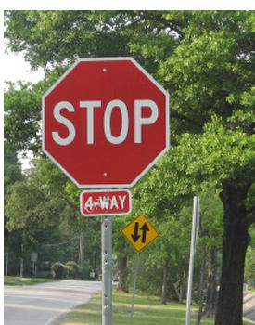
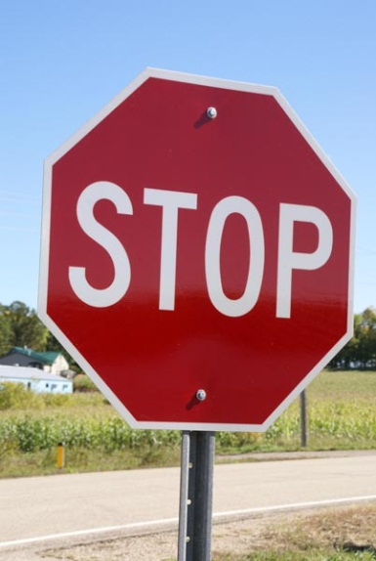
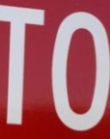
Correspondence and alignment
Correspondence: matching points, patches, edges, or regions across images
≈

Slide 4
Fitting and alignment: Methods
Global optimization / Search for parameters
Least squares fit
Robust least squares
Iterative closest point (ICP)
Hypothesize and test
Hough transform
RANSAC

Slide 5
Hough transform
Good
Robust to outliers: each point votes separately
Fairly efficient (much faster than trying all sets of parameters)
Provides multiple good fits
Bad
Some sensitivity to noise
Bin size trades off between noise tolerance, precision, and speed/memory
Can be hard to find sweet spot
Not suitable for more than a few parameters
grid size grows exponentially
Common applications
Line fitting (also circles, ellipses, etc.)
Object instance recognition (parameters are affine transform)
Object category recognition (parameters are position/scale)

Slide 6
RANSAC
RANdom SAmple Consensus:
Learning technique to estimate
parameters of a model by random
sampling of observed data
Fischler & Bolles in ‘81.
Notes:
Let me give you an intuition of what is going on. Suppose we have the standard line fitting problem in presence of outliers.
We can formulate this problem as follows: want to find the best partition of points in inlier set and outlier set such that…
The objective consists of adjusting the parameters of a model function so as to best fit a data set.
"best" is defined by a function f that needs to be minimized.
Such that the best parameter of fitting the line give rise to a residual error lower that delta
as when the sum, S, of squared residuals

Slide 7
RANSAC
Algorithm:
Sample (randomly) the number of points required to fit the model
Solve for model parameters using samples
Score by the fraction of inliers within a preset threshold of the model
Repeat 1-3 until the best model is found with high confidence
Notes:
Let me give you an intuition of what is going on. Suppose we have the standard line fitting problem in presence of outliers.
We can formulate this problem as follows: want to find the best partition of points in inlier set and outlier set such that…
The objective consists of adjusting the parameters of a model function so as to best fit a data set.
"best" is defined by a function f that needs to be minimized.
Such that the best parameter of fitting the line give rise to a residual error lower that delta
as when the sum, S, of squared residuals

Slide 8
RANSAC
Line fitting example
Algorithm:
Sample (randomly) the number of points required to fit the model (#=2)
Solve for model parameters using samples
Score by the fraction of inliers within a preset threshold of the model
Repeat 1-3 until the best model is found with high confidence
Notes:
Let me give you an intuition of what is going on. Suppose we have the standard line fitting problem in presence of outliers.
We can formulate this problem as follows: want to find the best partition of points in inlier set and outlier set such that…
The objective consists of adjusting the parameters of a model function so as to best fit a data set.
"best" is defined by a function f that needs to be minimized.
Such that the best parameter of fitting the line give rise to a residual error lower that delta
as when the sum, S, of squared residuals

Slide 9
RANSAC
Line fitting example
Algorithm:
Sample (randomly) the number of points required to fit the model (#=2)
Solve for model parameters using samples
Score by the fraction of inliers within a preset threshold of the model
Repeat 1-3 until the best model is found with high confidence
Notes:
Let me give you an intuition of what is going on. Suppose we have the standard line fitting problem in presence of outliers.
We can formulate this problem as follows: want to find the best partition of points in inlier set and outlier set such that…
The objective consists of adjusting the parameters of a model function so as to best fit a data set.
"best" is defined by a function f that needs to be minimized.
Such that the best parameter of fitting the line give rise to a residual error lower that delta
as when the sum, S, of squared residuals

Slide 10
RANSAC
Line fitting example
Algorithm:
Sample (randomly) the number of points required to fit the model (#=2)
Solve for model parameters using samples
Score by the fraction of inliers within a preset threshold of the model
Repeat 1-3 until the best model is found with high confidence
Notes:
Let me give you an intuition of what is going on. Suppose we have the standard line fitting problem in presence of outliers.
We can formulate this problem as follows: want to find the best partition of points in inlier set and outlier set such that…
The objective consists of adjusting the parameters of a model function so as to best fit a data set.
"best" is defined by a function f that needs to be minimized.
Such that the best parameter of fitting the line give rise to a residual error lower that delta
as when the sum, S, of squared residuals

Slide 11
RANSAC
Algorithm:
Sample (randomly) the number of points required to fit the model (#=2)
Solve for model parameters using samples
Score by the fraction of inliers within a preset threshold of the model
Repeat 1-3 until the best model is found with high confidence
Notes:
Let me give you an intuition of what is going on. Suppose we have the standard line fitting problem in presence of outliers.
We can formulate this problem as follows: want to find the best partition of points in inlier set and outlier set such that…
The objective consists of adjusting the parameters of a model function so as to best fit a data set.
"best" is defined by a function f that needs to be minimized.
Such that the best parameter of fitting the line give rise to a residual error lower that delta
as when the sum, S, of squared residuals

Slide 12
How to choose parameters?
Number of samples N
Choose N so that, with probability p, at least one random sample is free from outliers (e.g. p=0.99) (outlier ratio: e )
Number of sampled points s
Minimum number needed to fit the model
Distance threshold δ
Choose δ so that a good point with noise is likely (e.g., prob=0.95) within threshold
Zero-mean Gaussian noise with std. dev. σ: t²=3.84σ²
 | proportion of outliers e
s | 5% | 10% | 20% | 25% | 30% | 40% | 50%
2 | 2 | 3 | 5 | 6 | 7 | 11 | 17
3 | 3 | 4 | 7 | 9 | 11 | 19 | 35
4 | 3 | 5 | 9 | 13 | 17 | 34 | 72
5 | 4 | 6 | 12 | 17 | 26 | 57 | 146
6 | 4 | 7 | 16 | 24 | 37 | 97 | 293
7 | 4 | 8 | 20 | 33 | 54 | 163 | 588
8 | 5 | 9 | 26 | 44 | 78 | 272 | 1177

Slide 13
RANSAC
Good
Robust to outliers
Applicable for larger number of objective function parameters than Hough transform
Optimization parameters are easier to choose than Hough transform
Bad
Computational time grows quickly with fraction of outliers and number of parameters
Not good for getting multiple fits
Common applications
Computing a homography (e.g., image stitching)
Estimating fundamental matrix (relating two views)

Slide 14
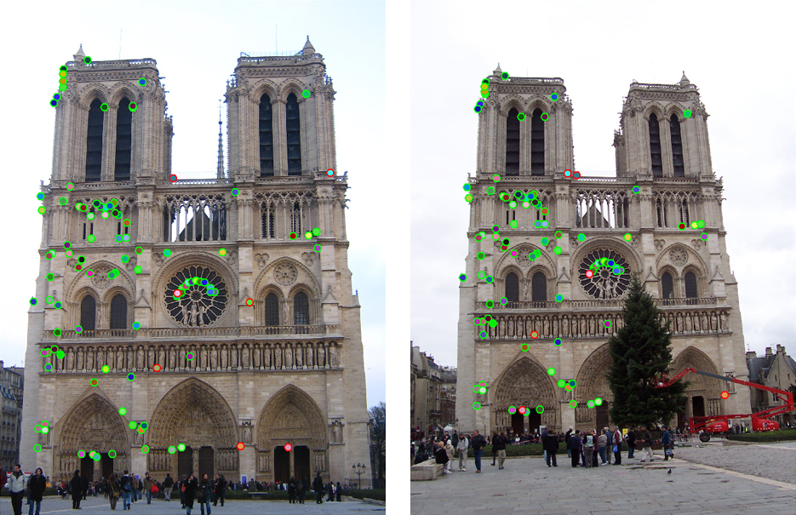
How do we fit the best alignment?

Slide 15
Alignment
Alignment: find parameters of model that maps one set of points to another
Typically want to solve for a global transformation that accounts for *most* true correspondences
Difficulties
Noise (typically 1-3 pixels)
Outliers (often 50%)
Many-to-one matches or multiple objects

Slide 16
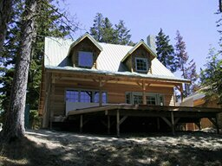
Parametric (global) warping
T
p = (x,y)
p’ = (x’,y’)
Transformation T is a coordinate-changing machine:
p’ = T(p)
What does it mean that T is global?
Is the same for any point p
can be described by just a few numbers (parameters)
For linear transformations, we can represent T as a matrix
p’ = Tp

Slide 17
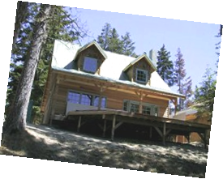
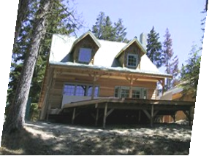
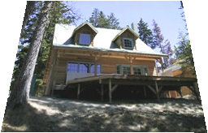
Common transformations
original
Transformed
translation
rotation
aspect
affine
perspective

Slide 18
Scaling
Scaling a coordinate means multiplying each of its components by a scalar
Uniform scaling means this scalar is the same for all components:
× 2

Slide 19
Scaling
Non-uniform scaling: different scalars per component:
X × 2, Y × 0.5

Slide 20
Scaling
Scaling operation:
Or, in matrix form:
scaling matrix S

Slide 21
2D rotation
(x’, y’)
(x, y)
x’ = x cos(θ) - y sin(θ)
y’ = x sin(θ) + y cos(θ)
θ

Slide 22
2D rotation
Polar coordinates…
x = r cos (φ)
y = r sin (φ)
x’ = r cos (φ + θ)
y’ = r sin (φ + θ)
Trig Identity…
x’ = r cos(φ) cos(θ) – r sin(φ) sin(θ)
y’ = r sin(φ) cos(θ) + r cos(φ) sin(θ)
Substitute…
x’ = x cos(θ) - y sin(θ)
y’ = x sin(θ) + y cos(θ)
(x’, y’)
(x, y)
θ
φ

Slide 23
2D rotation
This is easy to capture in matrix form:
Even though sin(θ) and cos(θ) are nonlinear functions of θ,
x’ is a linear combination of x and y
y’ is a linear combination of x and y
What is the inverse transformation?
Rotation by –θ
For rotation matrices
R

Slide 24
Basic 2D transformations
Scale
Shear
Rotate
Translate
Affine is any combination of translation, scale, rotation, shear
Affine

Slide 25
Affine transformation
Affine transformations are combinations of
Linear transformations, and
Translations
Properties of affine transformations:
Lines map to lines
Parallel lines remain parallel
Ratios are preserved
Closed under composition
or
Notes:
Ratios of distances along straight lines are preserved

Slide 26
Projective transformations
Projective transformations are combos of
Affine transformations, and
Projective warps
Properties of projective transformations:
Lines map to lines
Parallel lines do not necessarily remain parallel
Ratios are preserved
Closed under composition
Models change of basis
Projective matrix is defined up to a scale (8 DOF)

Slide 27
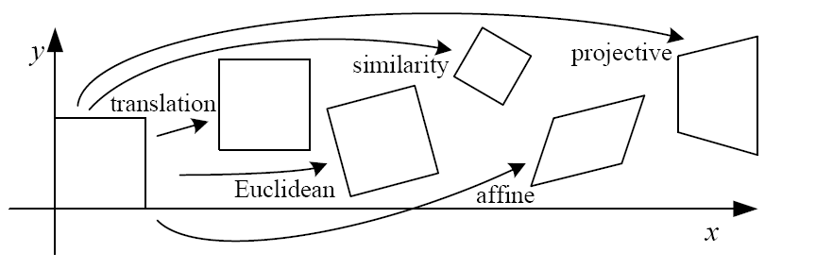
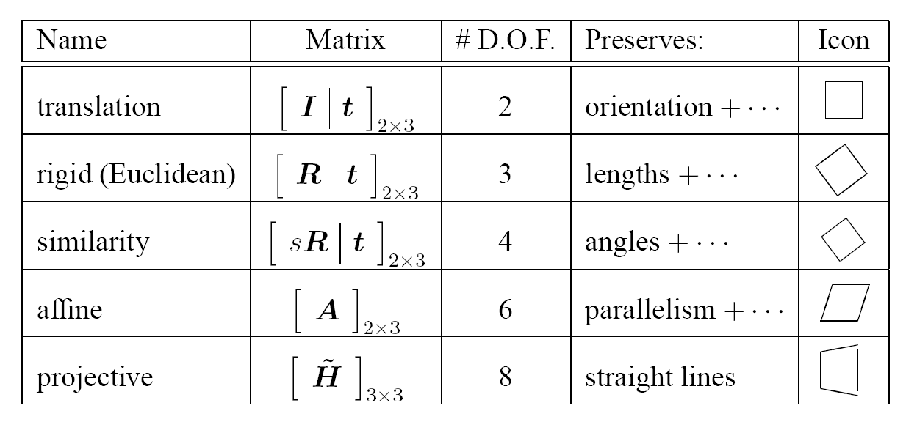
2D image transformations

Slide 28
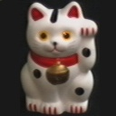
Example: solving for translation
A₁
A₂
A₃
B₁
B₂
B₃
Given matched points in {A} and {B}, estimate the translation of the object

Slide 29
Example: solving for translation
A₁
A₂
A₃
(t_{x}, t_{y})
B₁
B₂
B₃
Least squares solution
Write down objective function
Derived solution
Compute derivative
Compute solution
Computational solution
Write in form Ax=b
Solve using pseudo-inverse or eigenvalue decomposition

Slide 30
Example: solving for translation
A₁
A₅
B₄
A₂
A₃
(t_{x}, t_{y})
B₁
A₄
B₂
B₃
B₅
Problem: outliers
RANSAC solution
Sample a set of matching points (1 pair)
Solve for transformation parameters
Score parameters with number of inliers
Repeat steps 1-3 N times

Slide 31
Example: solving for translation
B₄
A₁
B₅
B₆
A₂
A₃
(t_{x}, t_{y})
B₁
A₄
B₂
B₃
A₅
A₆
Problem: outliers, multiple objects, and/or many-to-one matches
Hough transform solution
Initialize a grid of parameter values
Each matched pair casts a vote for consistent values
Find the parameters with the most votes
Solve using least squares with inliers

Slide 32
Example: solving for translation
(t_{x}, t_{y})
Problem: no initial guesses for correspondence

Slide 33
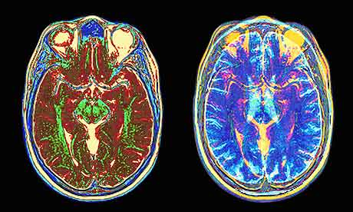
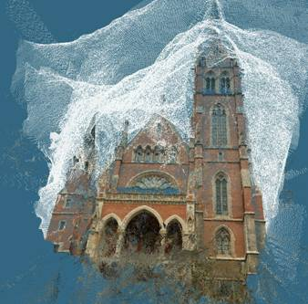
When no prior matched pairs exist
Hough transform and RANSAC not applicable
Important applications
Medical imaging: match brain scans or contours
Robotics: match point clouds

Slide 34
Iterative Closest Point (ICP)
Goal: estimate transform between two dense sets of points
Initialize transformation (e.g., compute difference in means and scale)
Assign each point in {Set 1} to its nearest neighbor in {Set 2}
Estimate transformation parameters
e.g., least squares or robust least squares
Transform the points in {Set 1} using estimated parameters
Repeat steps 2-4 until change is very small
https://www.youtube.com/watch?v=m64E47uvPYc
https://www.youtube.com/watch?v=uzOCS_gdZuM

Slide 35

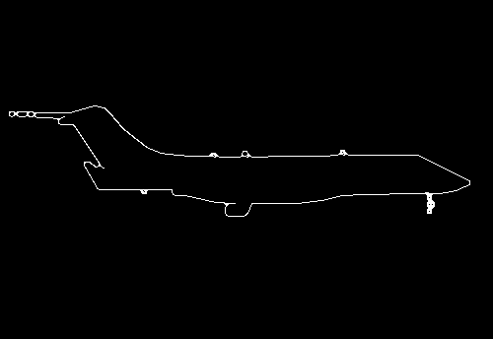
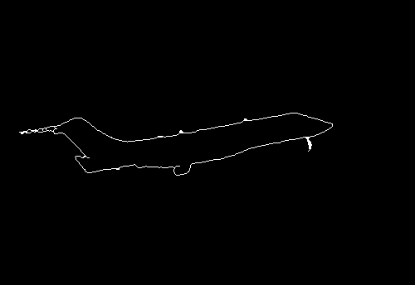
Example: aligning boundaries
p
q

Slide 36
Example: solving for translation
(t_{x}, t_{y})
Problem: no initial guesses for correspondence
ICP solution
Find nearest neighbors for each point
Compute transform using matches
Move points using transform
Repeat steps 1-3 until convergence

Slide 37
Algorithm summary
Least Squares Fit
closed form solution
robust to noise
not robust to outliers
Robust Least Squares
improves robustness to noise
requires iterative optimization
Hough transform
robust to noise and outliers
can fit multiple models
only works for a few parameters (1-4 typically)
RANSAC
robust to noise and outliers
works with a moderate number of parameters (e.g, 1-8)
Iterative Closest Point (ICP)
For local alignment only: does not require initial correspondences

Slide 38

Object instance recognition
B₃
A₁
A₃
Match keypoints to object model
Solve for affine transformation parameters
Score by inliers and choose solutions with score above threshold
A₂
B₁
B₂
Matched keypoints
Affine Parameters
# Inliers
Choose hypothesis with max score above threshold

Slide 39



Keypoint matching
1. Find a set of distinctive key- points
A₁
B₃
2. Define a region around each keypoint
A₂
A₃
3. Extract and normalize the region content
B₁
B₂
4. Compute a local descriptor from the normalized region
5. Match local descriptors

Slide 40
Finding the objects
Input Image
Stored Image
Match interest points from input image to database image
Matched points vote for rough position/orientation/scale of object
Find position/orientation/scales that have at least three votes
Compute affine registration and matches using iterative least squares with outlier check
Report object if there are at least T matched points

Slide 41
Object recognition using SIFT descriptors
Match interest points from input image to database image
Get location/scale/orientation using Hough voting
In training, each point has known position/scale/orientation wrt whole object
Matched points vote for the position, scale, and orientation of the entire object
Bins for x, y, scale, orientation
Wide bins (0.25 object length in position, 2x scale, 30 degrees orientation)
Vote for two closest bin centers in each direction (16 votes total)
Geometric verification
For each bin with at least 3 keypoints
Iterate between least squares fit and checking for inliers and outliers
Report object if > T inliers (T is typically 3, can be computed to match some probabilistic threshold)

Slide 42
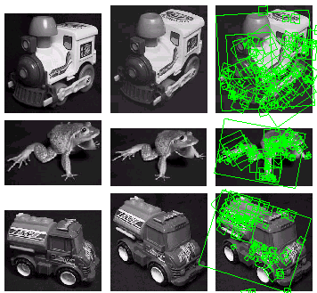
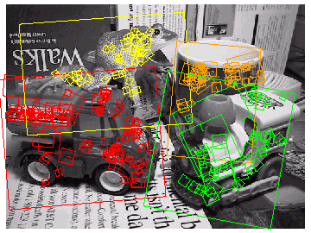
Examples of recognized objects

